Slide 1
We are all to gather
Rémi Forax
Université Gustave Eiffel – June 2024

Slide 2
We are all together
Rémi Forax
Université Gustave Eiffel – June 2024

Slide 3
We are all to gather
Rémi Forax
Université Gustave Eiffel – June 2024

Slide 4

Don’t believe what I’m saying !

Slide 5
Me, myself and I
Rémi Forax
  Assistant Prof at University Gustave Eiffel
  Expert for lambda, module, record, etc
    Feel free to google me if you want to know more ...

Slide 6
Outline
The Gatherer API
Performance and limitations

Slide 7
A stream is defined by ...
  a source, abstracted as a Spliterator
  some intermediate operations
  a terminal operation that drives the pipeline
toList()
filter
flatMap
Spliterator
Intermediate op
Intermediate op
Terminal op

Slide 8
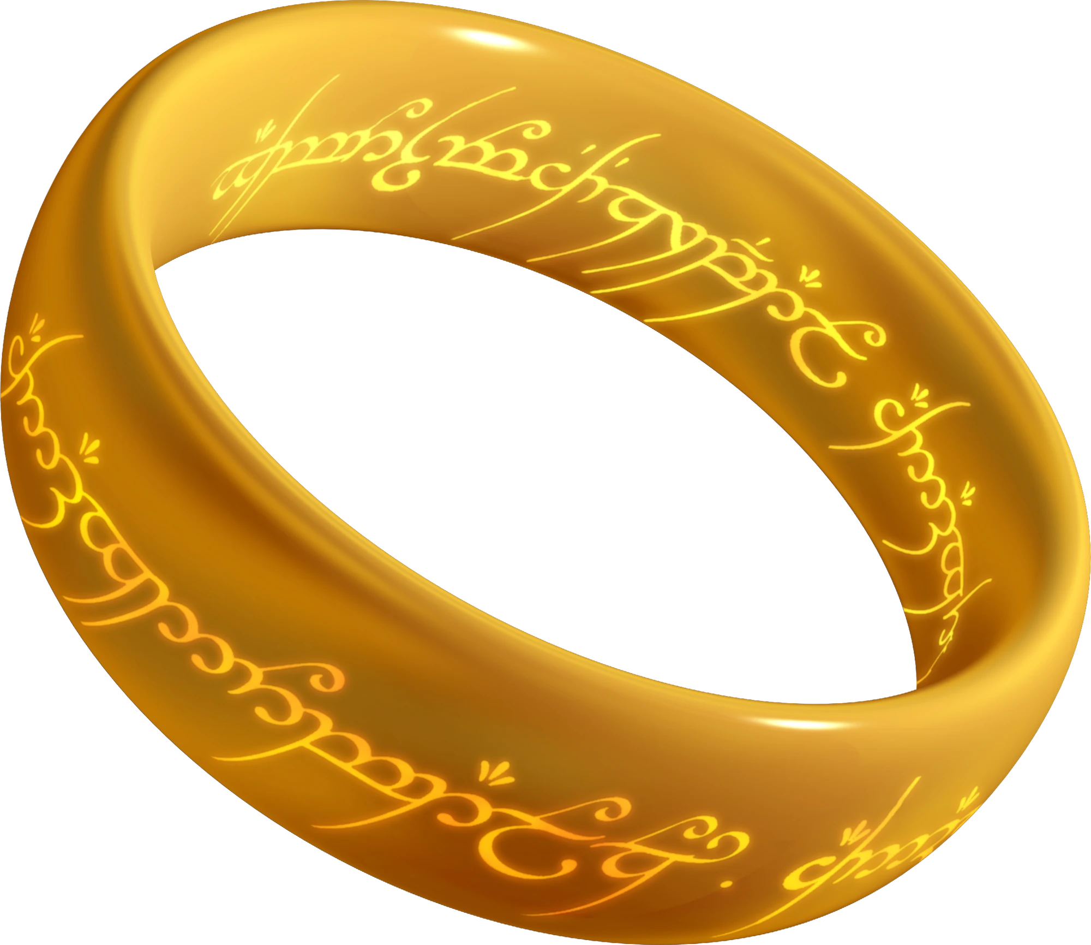
A Gatherer
Abstracts any intermediate operation
  Users can define their own
New intermediate method Stream.gather()
  stream.gather(Gatherers.fold(…)).toList()
Modeled like a Collector
  j.u.s.Gatherers contains predefined Gatherer

Slide 9
An intermediate operation
  Push (or not) transformed elements to the next stage
    Back-propagate “I want more !”
  May have state (limit, distinct, sorted, ...)
filter
flatMap
current op
downstream op

Slide 10
Modeling an intermediate op
@FunctionalInterface
interface Integrator {
  boolean integrate (???, E element, Downstream<T> downstream)
    May push downstream + “I want more”
push(element)
current op
downstream op

Slide 11
Interface Downstream<T>
Conceptually a Consumer<T>
  boolean push(T element)
    Returns true → “I want more”
  isRejecting()
    Is the next stage rejecting elements (will return false) ?

Slide 12
+ State management
Gatherer.of() uses 4 functions
  initializer: Supplier<A>
    Create a state
  integrator: (A state, E element, Downstream<T> downstream) → boolean
    Modify state and/or push downstream (+ back-propagate return type)
  combiner: BinaryOperator<A>
    Combine two states, return a new state
  finisher: BiConsumer<A, Downstream<T>>
    Push downstream at the end
interface Downstream<T> {
boolean push(T element);
boolean isRejecting();
}

Slide 13
Live Code !

Slide 14
Gatherer API

Slide 15
Gatherer<E, A, T>
initializer: Supplier<A>
  Create a state
integrator (A state, E element, Downstream<T> downstream) → boolean
  Modify state and/or push downstream (+ back-propagate return type)
combiner: BinaryOperator<A>
  Combine two states, return a new state
finisher: BiConsumer<A, Downstream<T>>
  Push downstream at the end
interface Downstream<T> {
boolean push(T element);
boolean isRejecting();
}

Slide 16
Creating a Gatherer : 3 axis
Only Sequential vs Parallelizable
  Gatherer.ofSequential() vs Gatherer.of() + combiner?
Stateless vs Stateful
  integrator vs initializer + integrator + finisher?
Short-circuit vs Greedy
  integrator vs Integrator.ofGreedy()

Slide 17
Greedy vs short-circuit
If a Gatherer does not short-circuit
  It can be merged with a subsequent gatherer
  It can be merged with a subsequent collector
Wraps the Integrator into Greedy.of(integrator)

Slide 18
Performance ?

Slide 19
WARNING ! WARNING !
The stream API relies heavily on the VM being able to correctly propagates type profiles
  If that strategy does not work, the VM records type profiles
There is usually no profile pollution in a micro-benchmark so real world scenario performance may differ !

Slide 20
Performance map + sum
public int stream_map_sum() {
return values.stream().map(String::length).reduce(0, Integer::sum);
} // 481.222 ± 1.560 us/op
public int stream_mapToInt_sum() {
return values.stream().mapToInt(String::length).sum();
} // 102.089 ± 0.672 us/op
public int gatherer_map_sum() {
return values.stream().gather(map(String::length)).reduce(0, Integer::sum);
} // 552.384 ± 3.405 us/op
No primitive specialization ...
* values is a List of 100_000 strings

Slide 21
Performance map + toList
public List<Integer> stream_map_toList() {
return values.stream().map(String::length).toList();
} // 332.322 ± 0.512 us/op
public List<Integer> gatherer_map_toList() {
return values.stream().gather(map(String::length)).toList();
} // 558.873 ± 6.200 us/op
Why using a Gatherer is slower ? ...

Slide 22
Performance map + count
public long stream_map_count() {
return values.stream().map(String::length).count();
} // 0.009 ± 0.001 us/op
public long stream_mapToInt_count() {
return values.stream().mapToInt(String::length).count();
} // 0.009 ± 0.001 us/op
public long gatherer_map_count() {
return values.stream().gather(map(String::length)).count();
} // 101.993 ± 0.105 us/op
=> spliterator characteristics are not propagated !

Slide 23
Performance map + collect(summing)
public int stream_map_collect() {
return integers.stream().map(v -> v + 1).collect(summingInt(v -> v));
} // 311.241 ± 62.204 us/op
public int gatherer_map_collect() {
return integers.stream().gather(map(v -> v + 1)).collect(summingInt(v -> v));
} // 307.455 ± 0.222 us/op
gather + collect are fused into one operation, yeah !
* integers is a List of 100_000 Integers

Slide 24
Performance issues
No primitive specialization
  mapToInt/flatMapToInt, etc
    Same issue with collectors
    Valhalla generics to the rescue ??
Spliterator characteristics are not propagated
  Same issue with collectors
    For ex: Stream.toList() can presize, not Collectors.toList()

Slide 25
Executive Summary

Slide 26
Gatherer API
User defined intermediary operations
    4 functions: initializer, integrator, combiner, finisher
    3 axis: only-sequential / statefulness / short-circuitability
Still in preview in Java 23
  more predefined Gatherers ?
  Spliterator characteristics could be propagated ?

Slide 27
Questions ?
https://github.com/forax/we_are_all_to_gather

